Slide 1

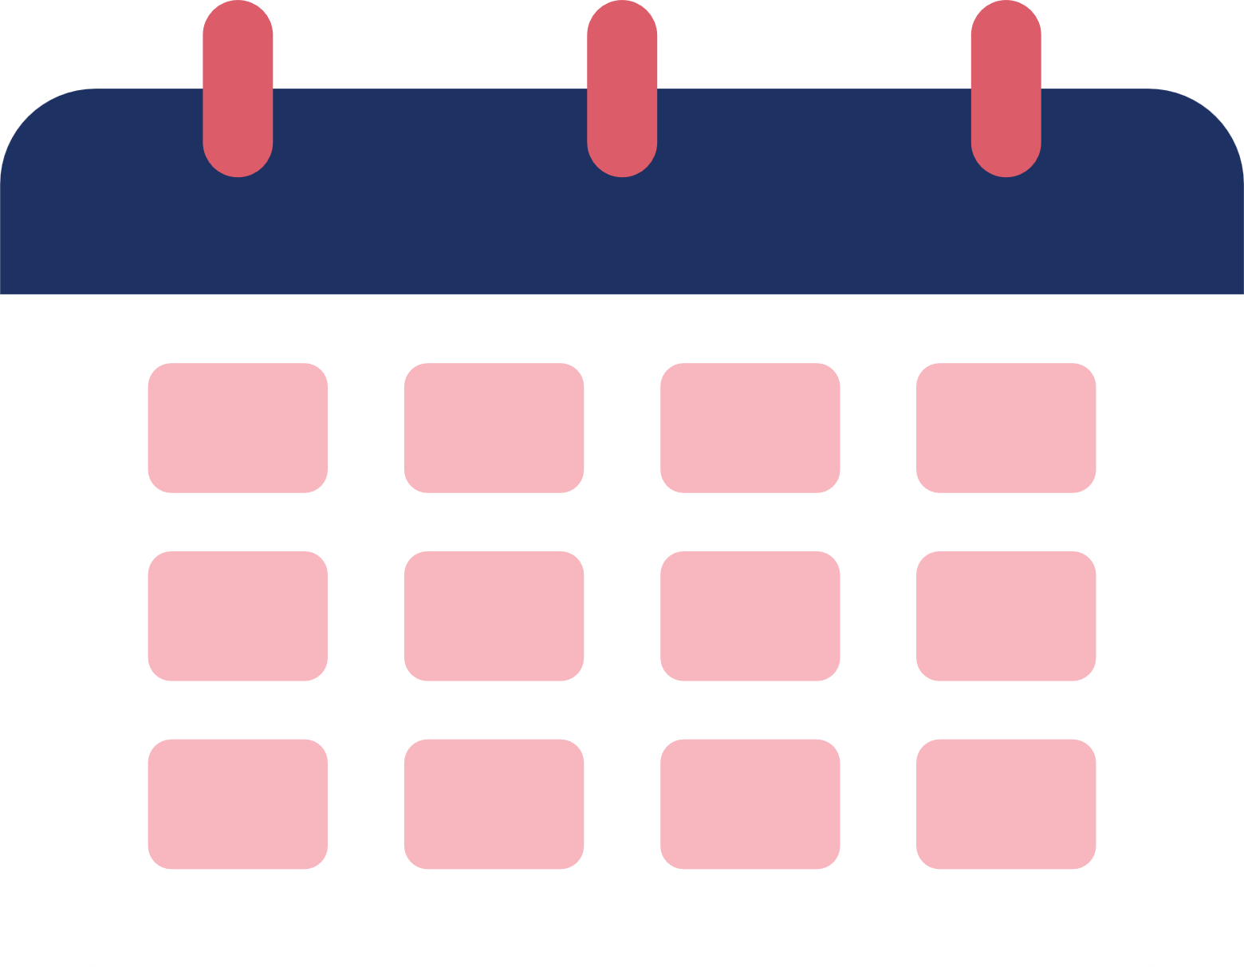
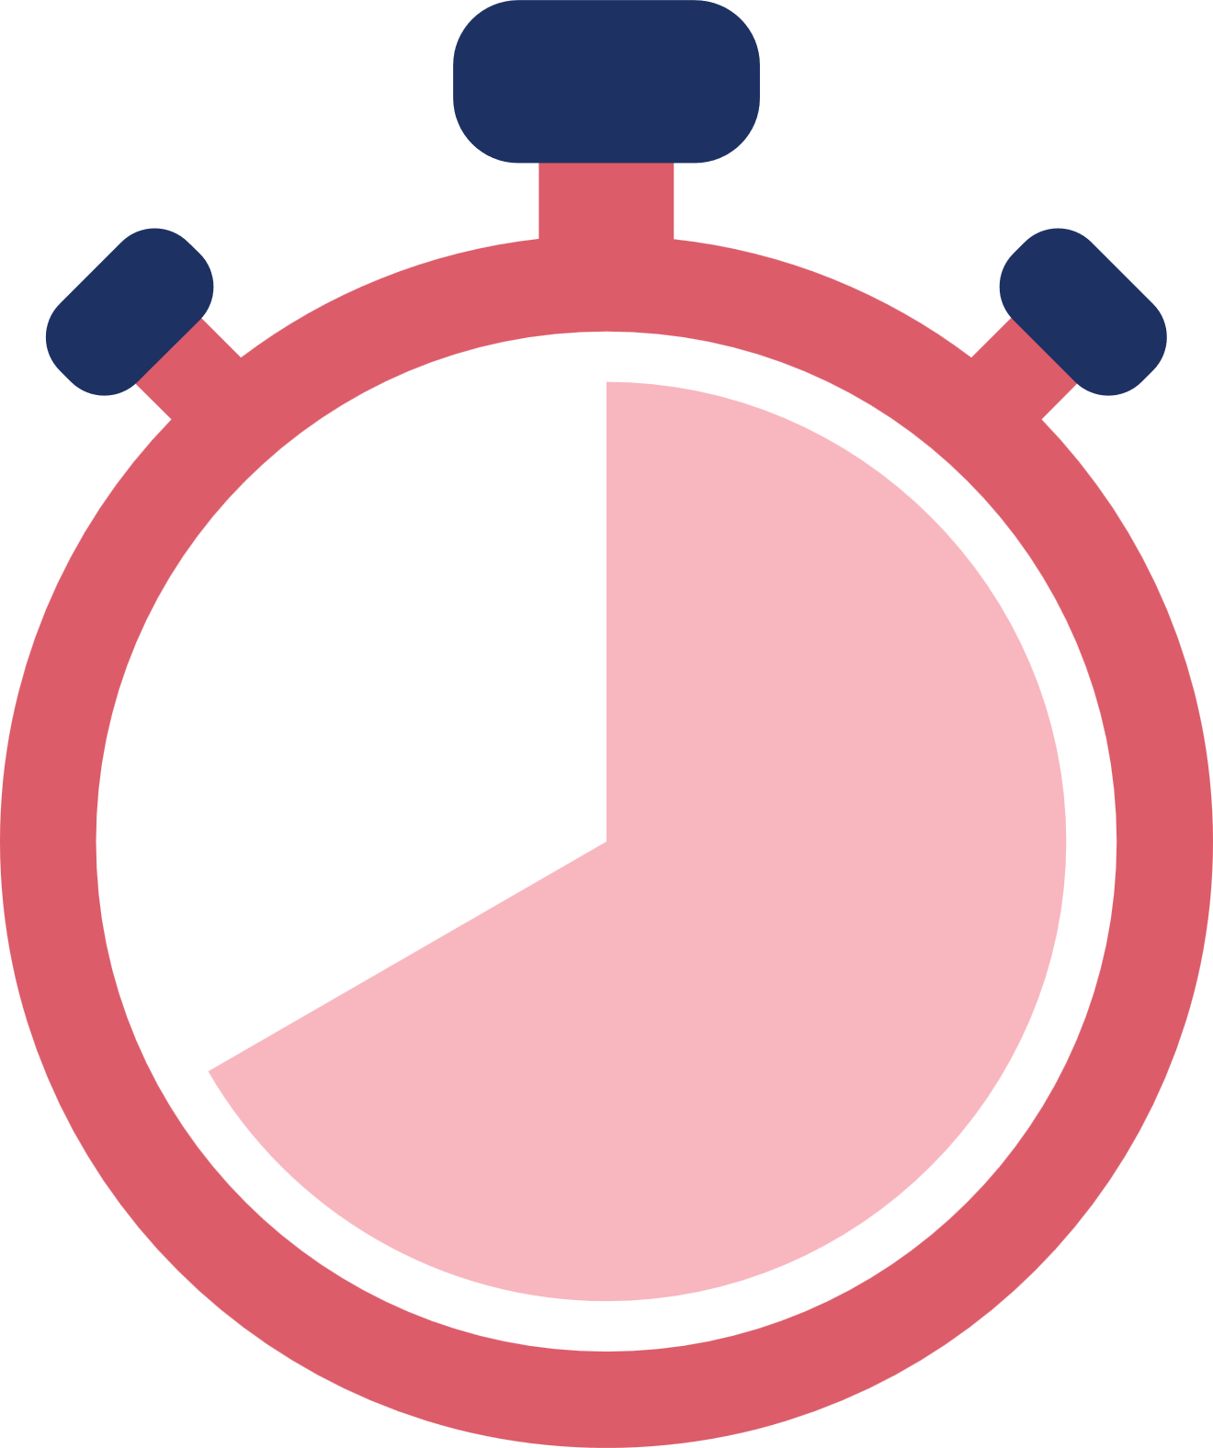

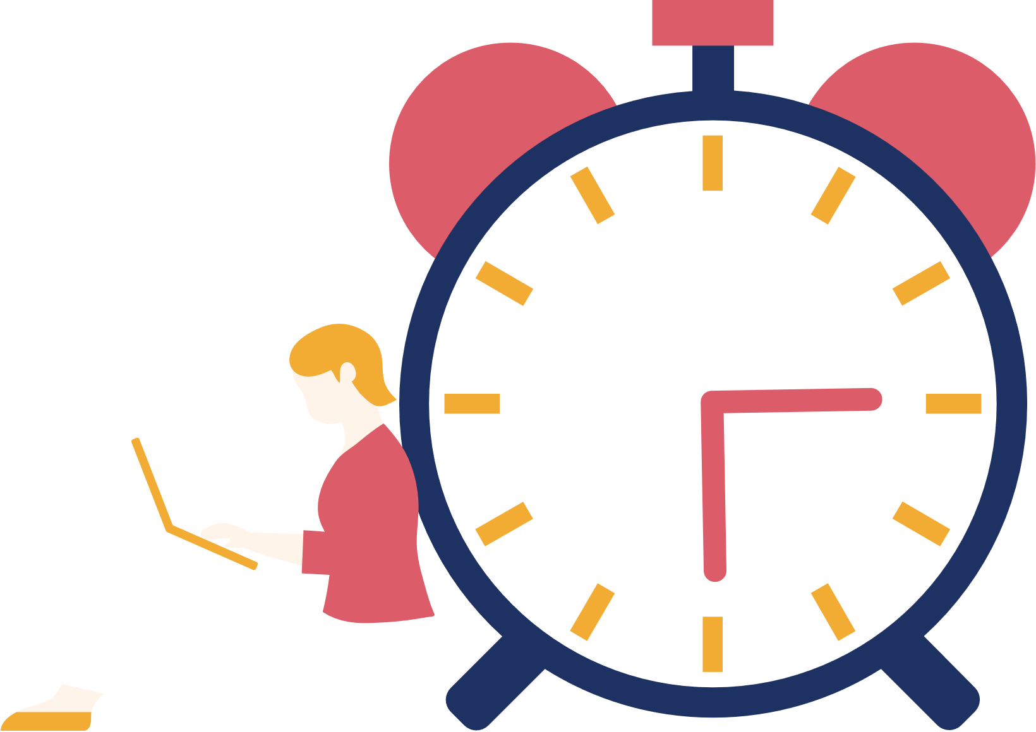
DAILY TASK
MANAGEMENT APP
BY:- Khushi patil(A216)
Pallavi Dangane(A246)
Anannya Londhe(A242)

Slide 2

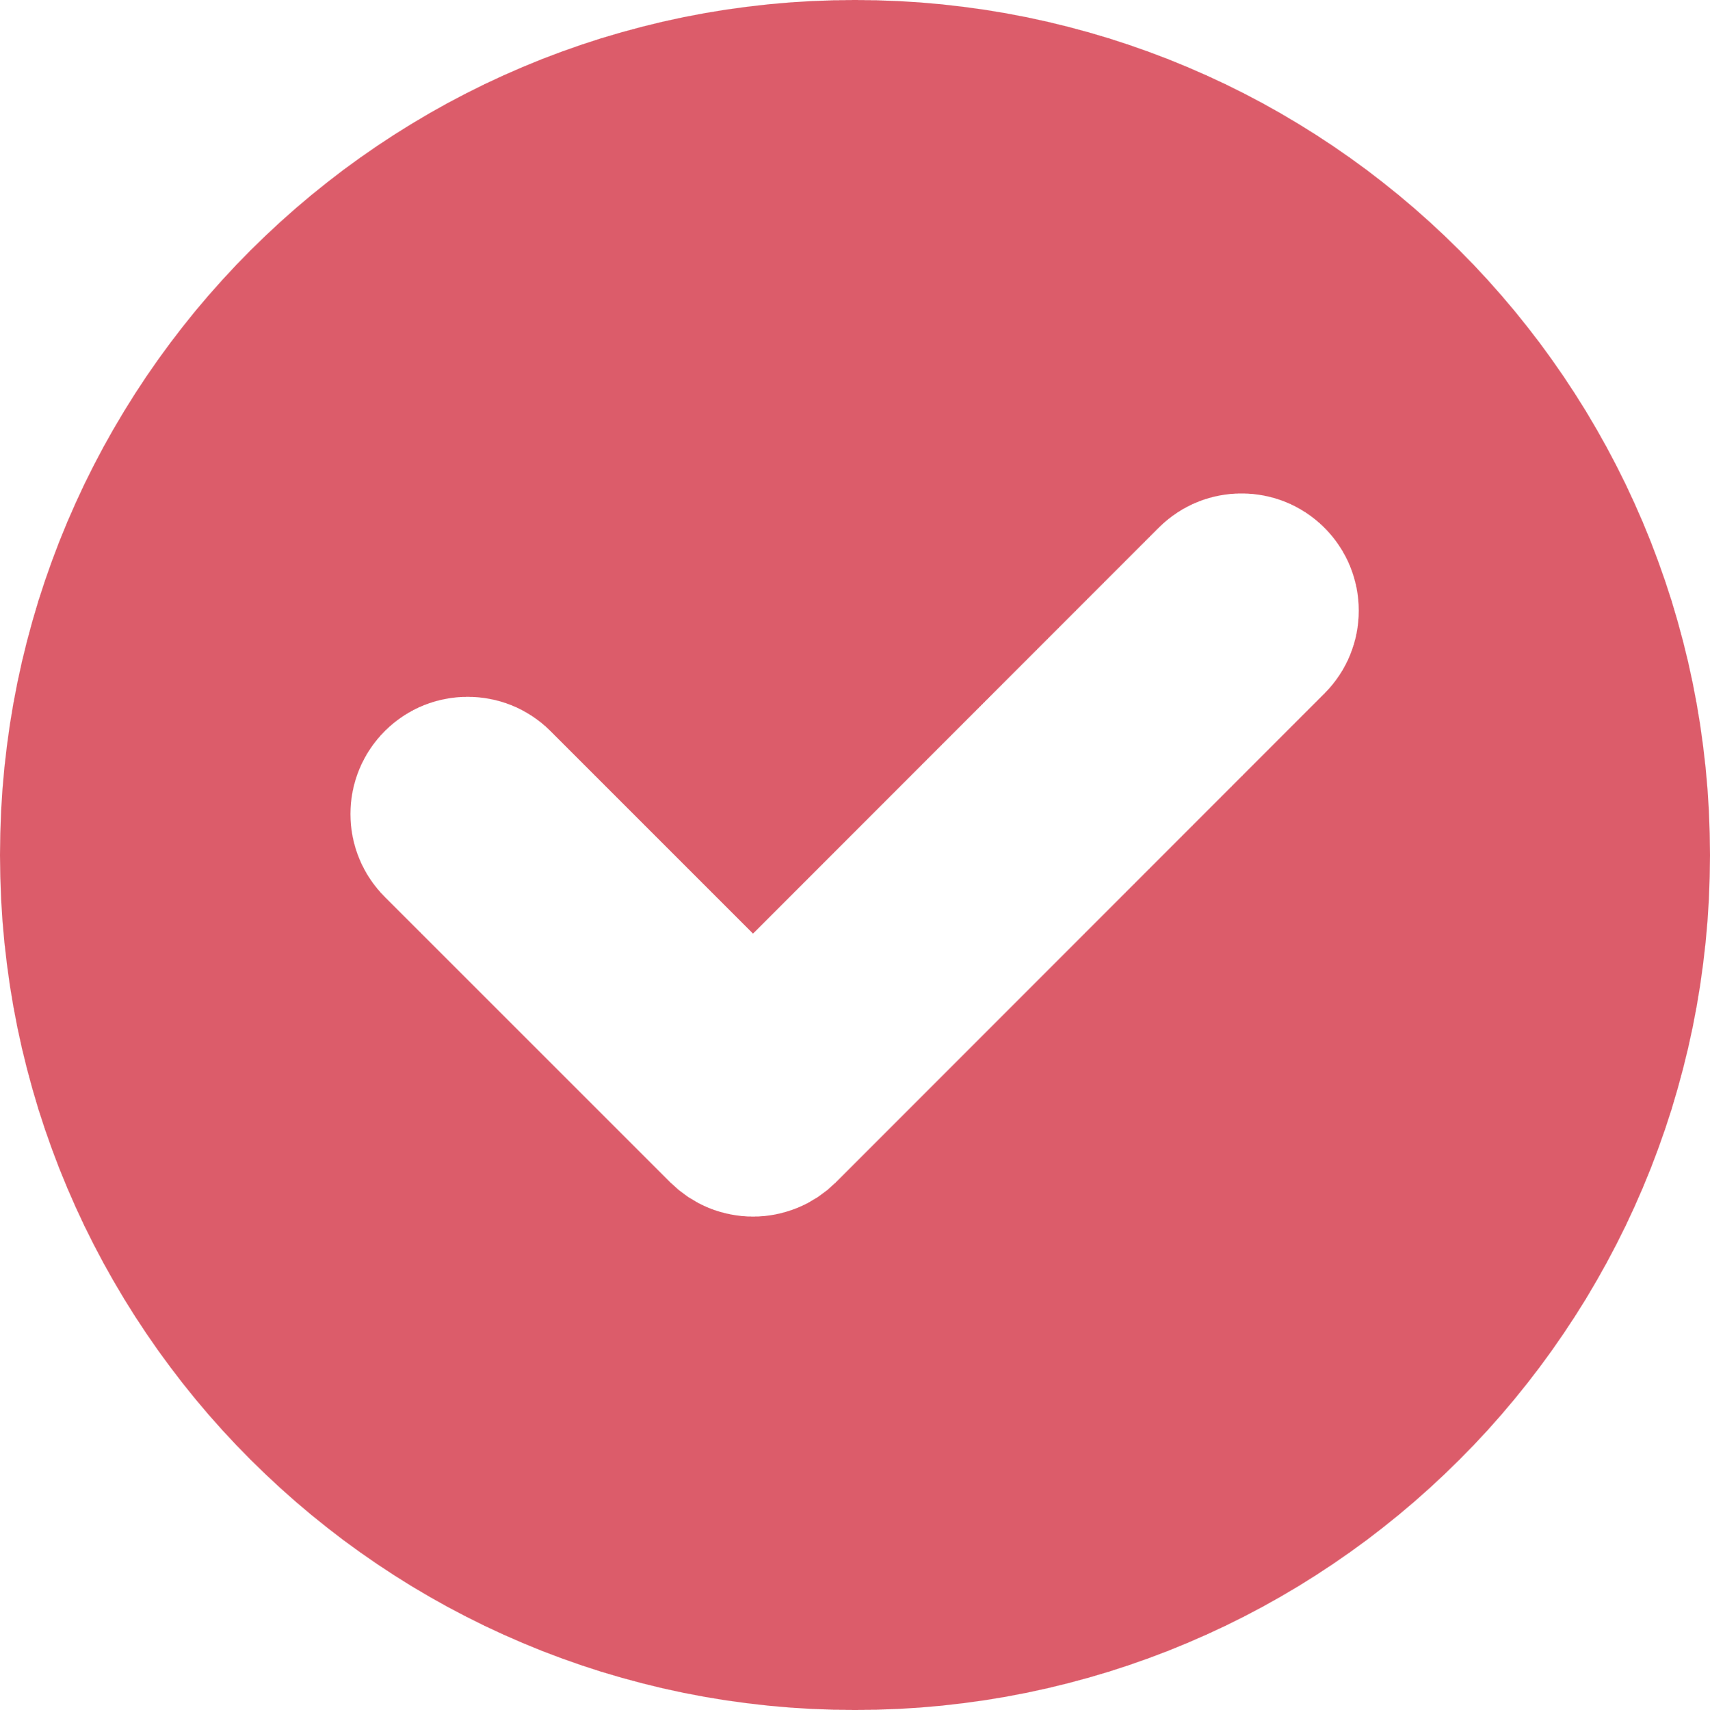
Importance of Task Management
Boosts Productivity: Focuses on important tasks, increasing output.
Balance: Attaining a balance between work and personal life.
Time Management: Allocates time effectively, meeting deadlines.
Stress: Reducing stress through effective planning.

Slide 3
Users need and behaviour
Target users
Users Needs
Behaviour
Motivation
Professionals, students, freelancers, and home managers who need a tool to organize tasks and manage deadlines efficiently.
Simple task creation, prioritization, progress tracking, device sync, and productivity insights.
Users add, update, and review tasks daily, rely on reminders, and customize views for quick overviews.
To boost productivity, reduce stress, achieve goals, and feel accomplished by staying organized.

Slide 4
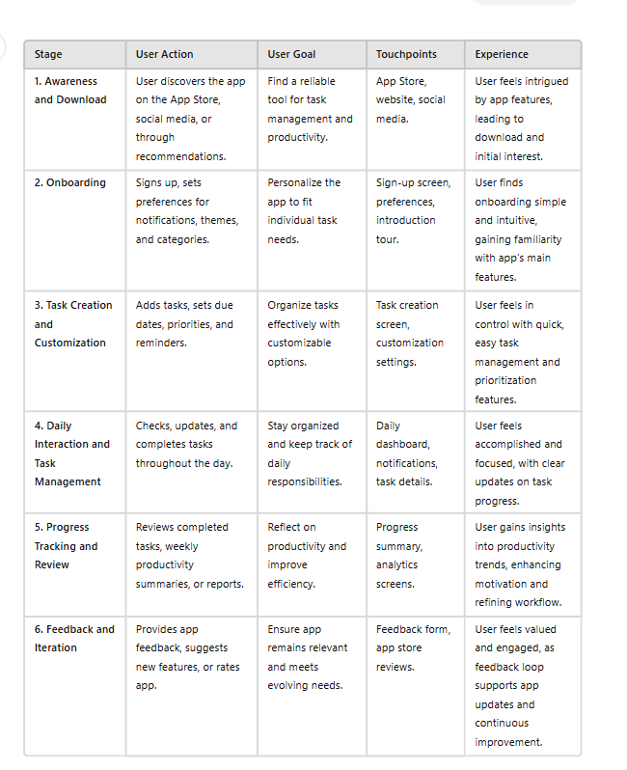
User Journey Map

Slide 5
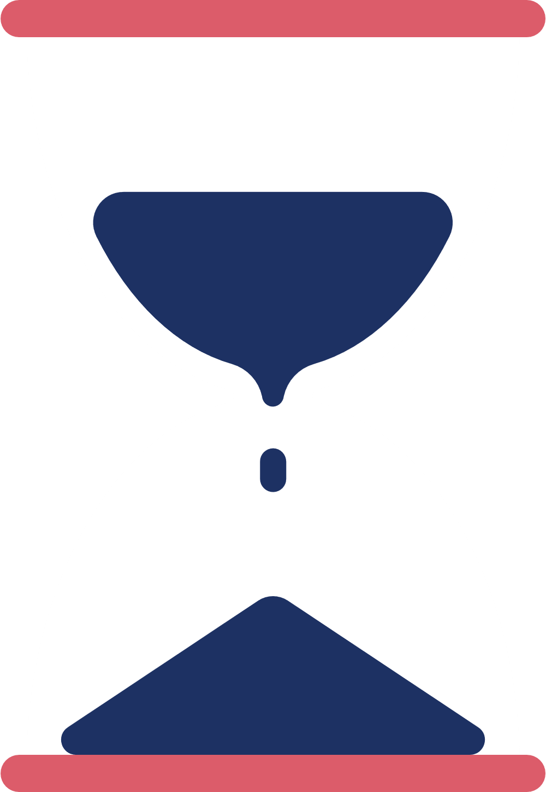

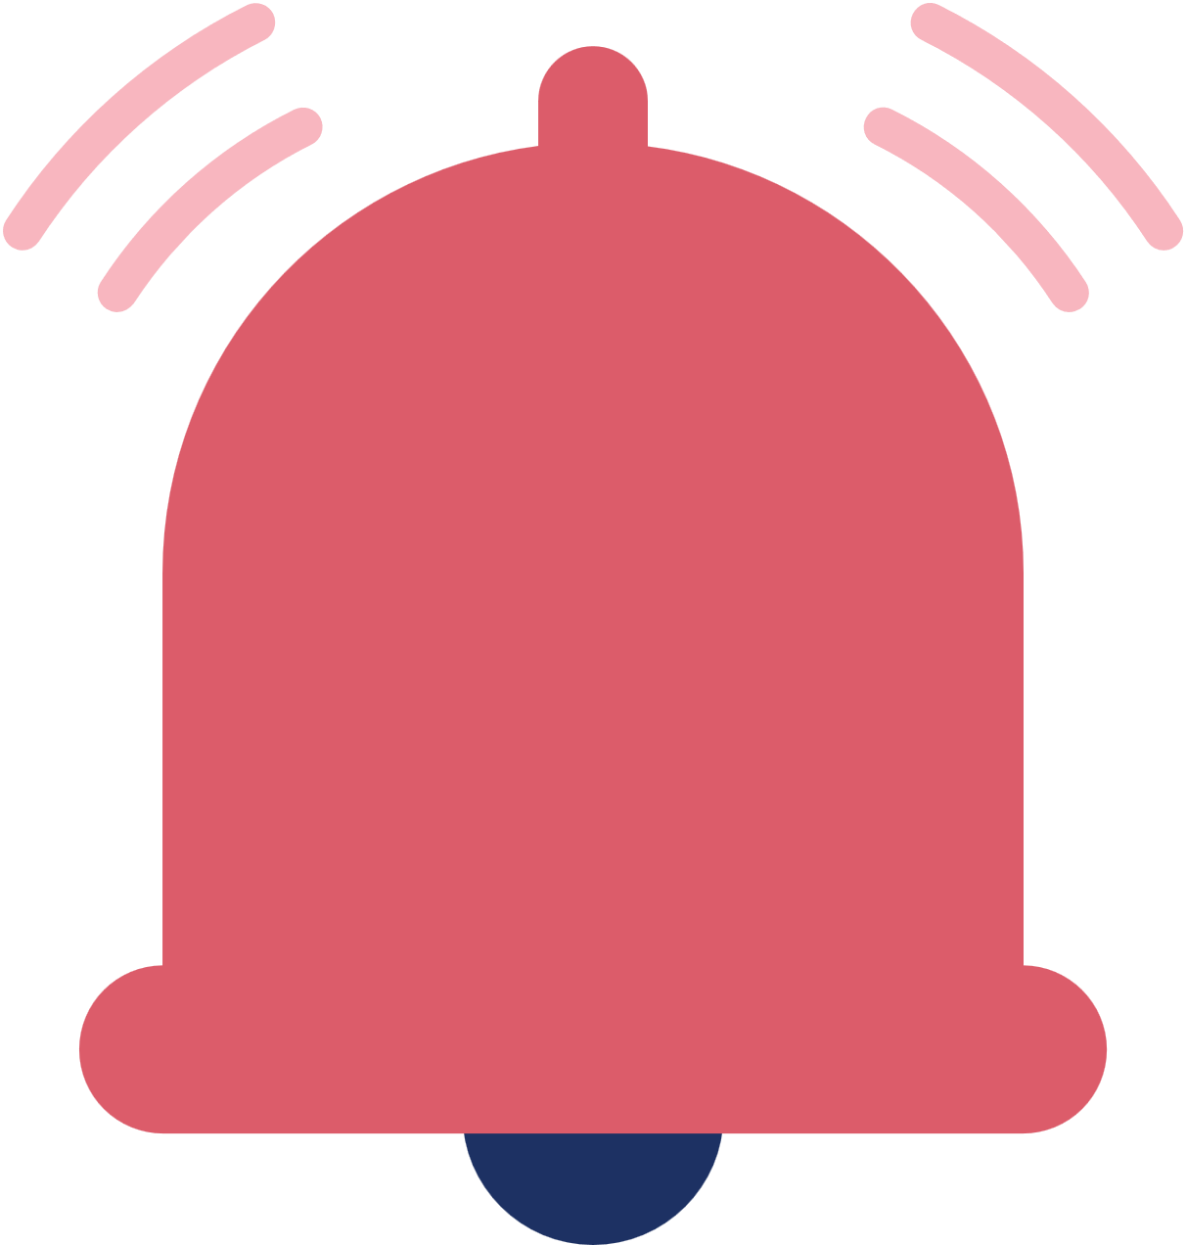
Evaluation Focus AND Criteria
The evaluation checks usability for ease, functionality for smooth performance, aesthetics for visual appeal, and user satisfaction for productivity needs.
The evaluation criteria include task completion time, error rate, user satisfaction, and accessibility compliance.
It also assesses quick performance and accessibility for inclusivity.
Together, these criteria ensure a reliable, user-friendly, and inclusive experience while protecting user data and optimizing performance.

Slide 6

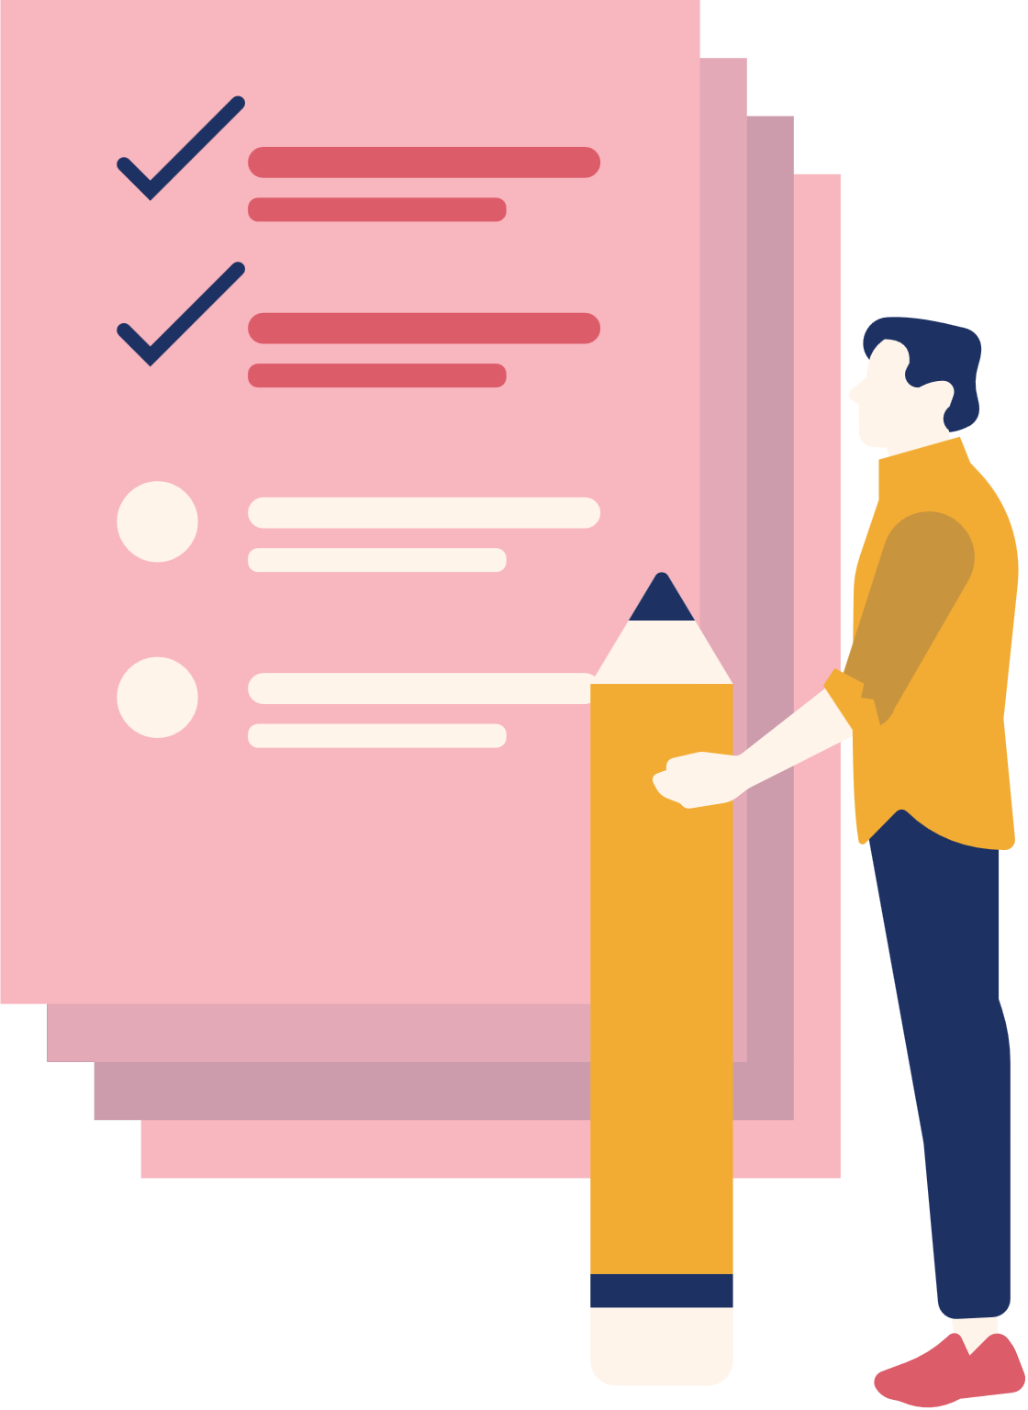
Evaluation
1.
Methods Used: User interviews and usability testing identified app pain points and user experiences.
2.
Participants: A diverse group of 10-15 participants represented various user needs.
3.
Objective: The goal was to enhance usability and improve the overall user experience.

Slide 7



Findings
Most task management apps lack built-in communication, forcing users to switch between apps for task discussions and updates.
Users often struggle with categorizing tasks based on priority or status (ongoing, completed, etc.).
Users may miss key updates when notifications lack detail or get lost among others.
Some task management apps don't allow users to personalize or manage their settings easily

Slide 8
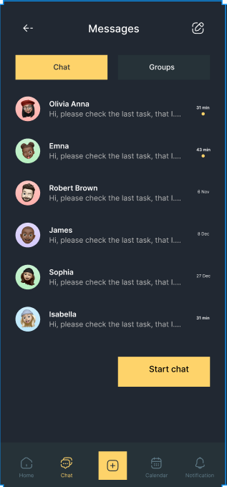
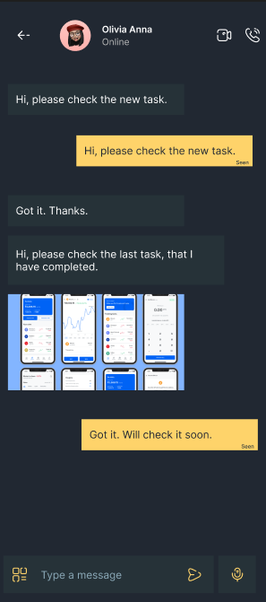
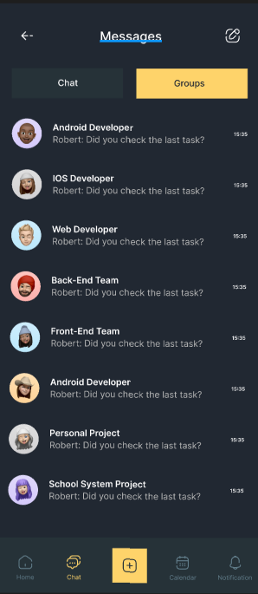
Proposed Design Improvement
1.
This app combines both task management and a chat/messaging system. It has screens dedicated to messages and group chats, allowing users to discuss tasks within the same app.

Slide 9
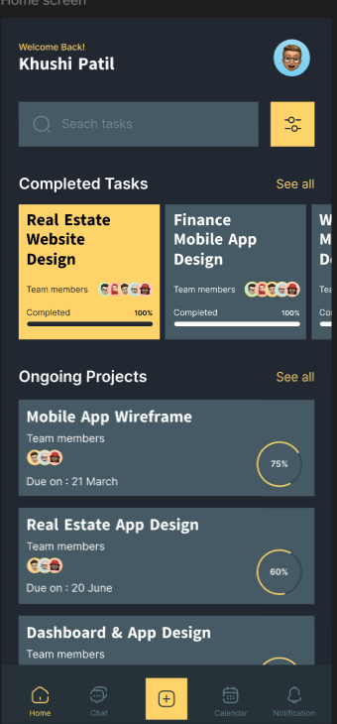
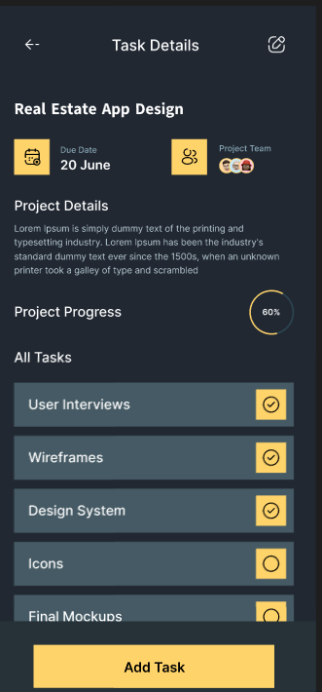
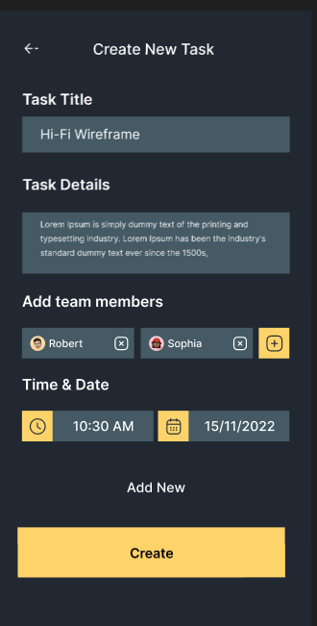
Proposed Design Improvement
2.
The app has a clear breakdown of tasks (e.g., "Completed Tasks" and "Ongoing Projects") and allows for detailed task management through categories and labels.

Slide 10
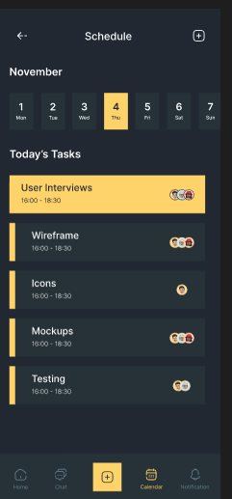
Proposed Design Improvement
3.
The scheduling section integrates task deadlines with a calendar view, helping users visualize their daily schedule and plan their tasks more effectively.

Slide 11
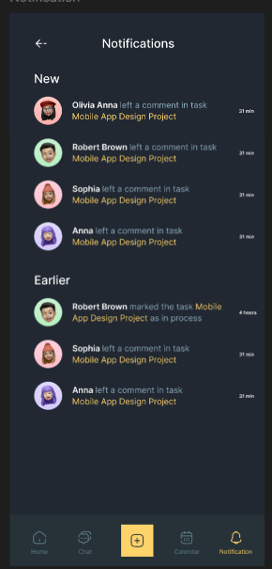
Proposed Design Improvement
4.
The notification section is detailed, providing updates on task progress, messages, and other relevant events within the app.

Slide 12
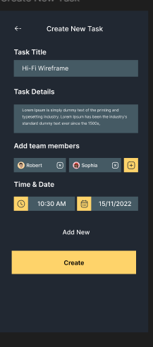
Proposed Design Improvement
5.
The "Create New Task" feature includes an option to add team members, making it easier to assign tasks directly within the app.

Slide 13
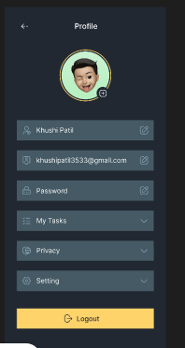
Proposed Design improvement
6.
The "Profile" screen allows for personalized account management, including privacy settings, password management, and a logout option.

Slide 14
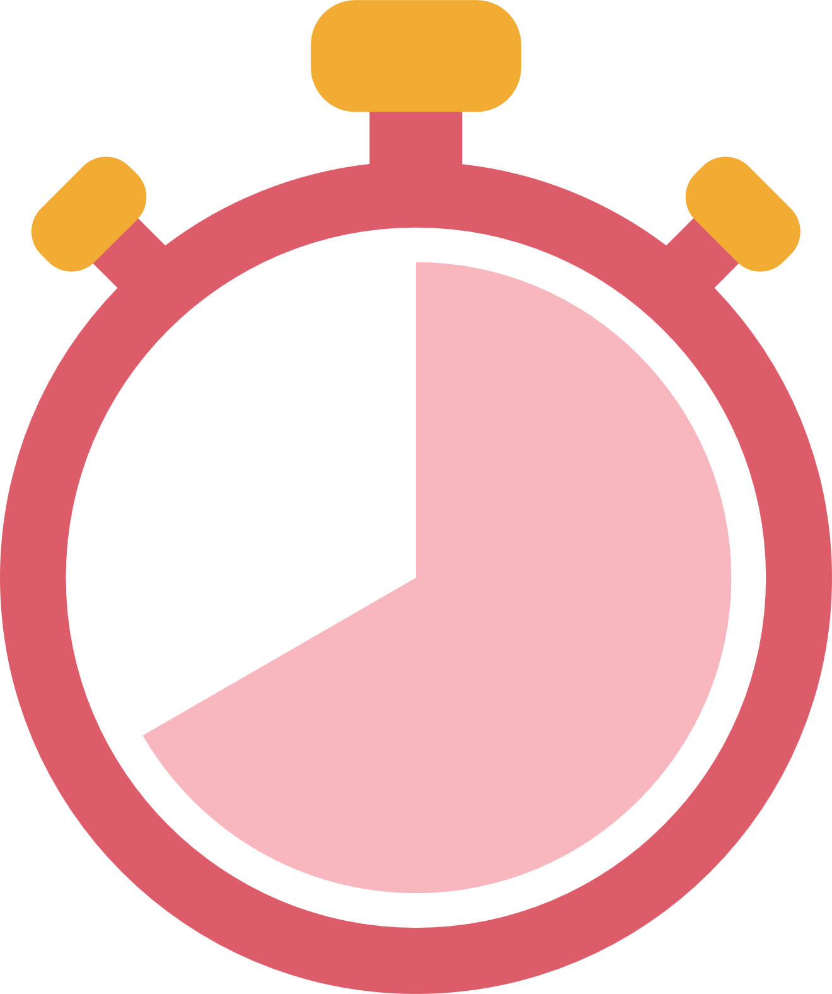
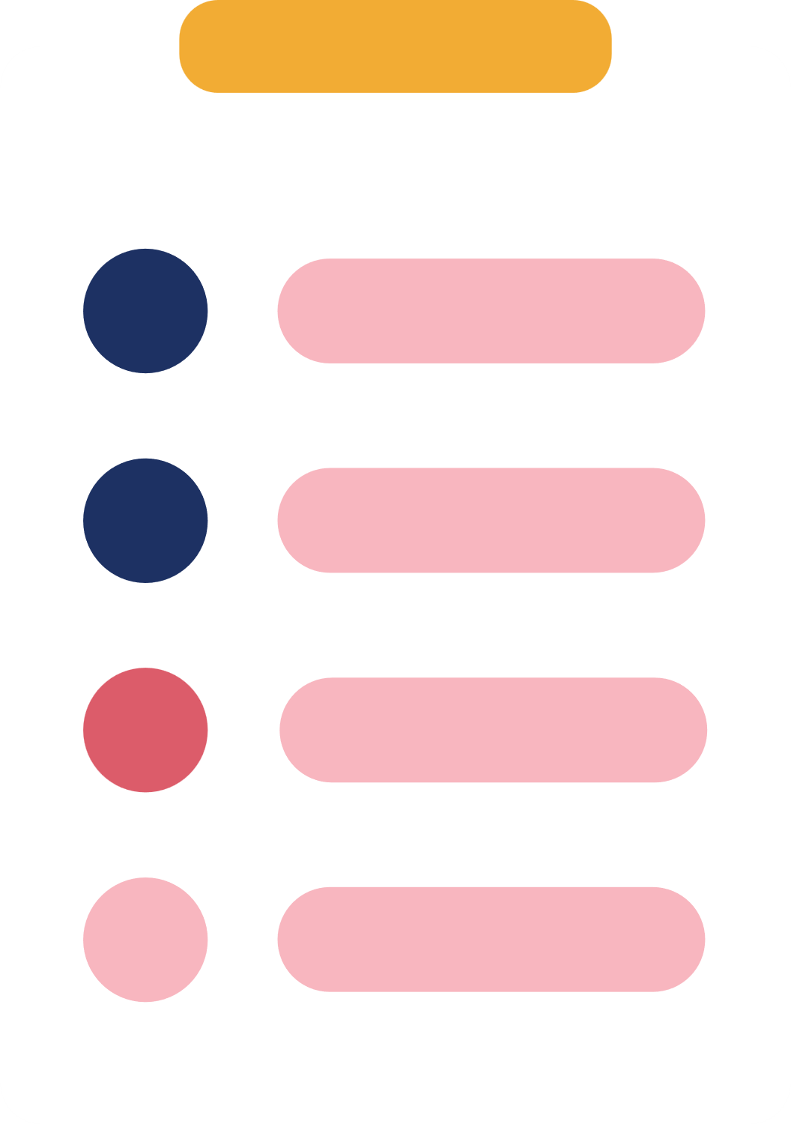
Impact of Redesign
1
Enhances task tracking and reduces missed updates.
2
Improves team communication by highlighting key changes.
3
Increases productivity by keeping users focused on important tasks.
4
Minimizes delays and errors by ensuring timely information flow.

Slide 15


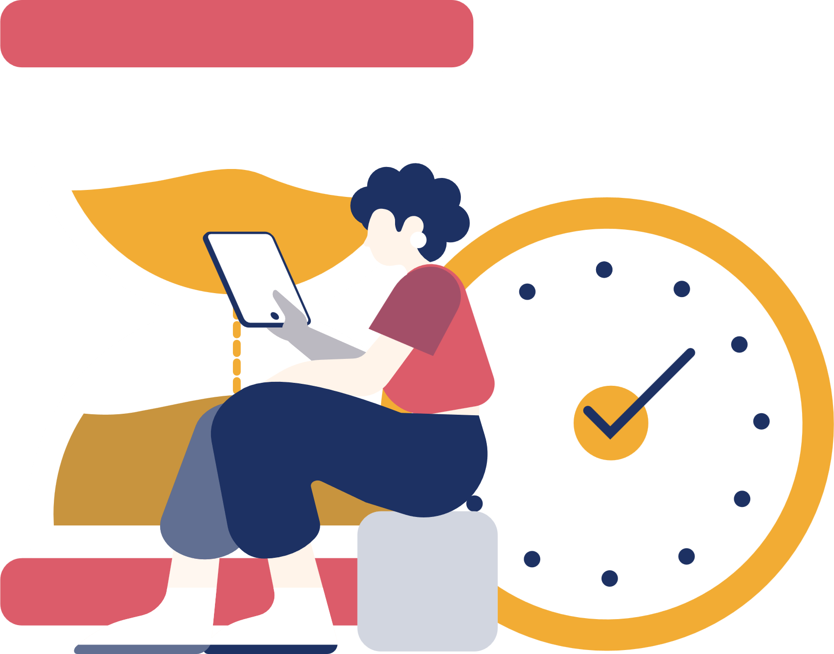
Conclusion
The redesign of the app enhances task management by integrating communication, detailed notifications, and efficient scheduling, providing a more streamlined, user-friendly experience that improves productivity and collaboration.
Link of prototype
https://www.figma.com/design/ndNkNCjxpXrzIjdRDGx5m9/DayTask---Task-Management-App-UI-Kit-(Community)?node-id=0-1&node-type=canvas&t=sow1zh3iAx9yHkAn-0

Slide 16
